Slide 1

Trustee Training
Presented by
VFW Auxiliary
Department of Missouri

Slide 2
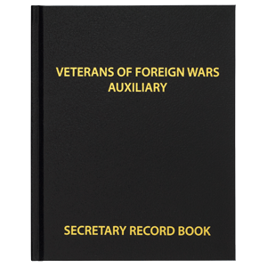
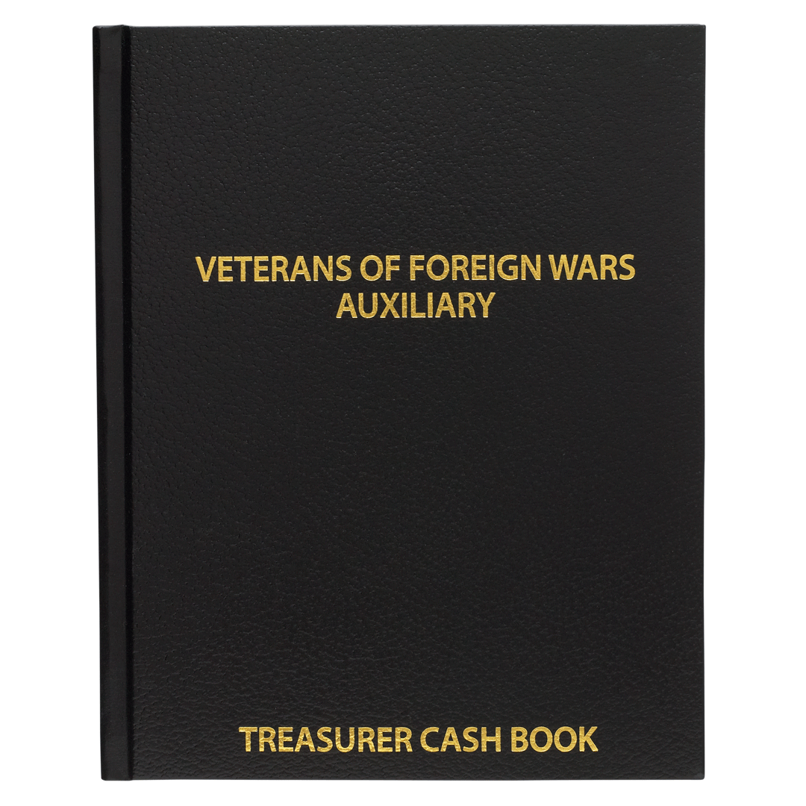
Sec 814 – Trustees, Duties of
It shall be the duty of the Trustees.
  To properly audit the books and record of Auxiliary Treasurer and Secretary.
    They shall verify all expenditures of the Auxiliary and certify by their signatures to the correctness of each bill before payment may be made of same by the Treasurer.
    They shall audit the records and accounts of all committees, Officers and members, having to do with the receipt and expenditure of the Auxiliary funds and perform such other duties incident to their office as the Auxiliary may direct or the law requires.
    No later than the end of the month following the expiration of each quarterly period.
Notes:
Trustees are important
They keep the Treasurer honest
We have had Treasurer’s embezzle money from the Auxiliary.
If the audit is not properly done, the bond will be invalid

Slide 3
Due dates of Auxiliary Audits
Quarter | Months Covered | Audit Completed by | Approved Audit sent to Department Treasurer no later than
First | January, February, March | April 30 Annually | May 31, annually
Second | April, May, June | July 31, Annually Note: Both outgoing and incoming Treasurers and Trustees should be present | August 31, Annually
Third | July, August, September | October 31, Annually | November 30, Annually
Fourth | October, November, December | January 31, Annually | February 28, Annually
Notes:
Bylaws – Sec 814 – Trustees, Duties of (All Levels)
B. It shall be the duty of the Trustees
1. To properly audit the books and records of the Auxiliary Treasurer and Secretary no later than the end of the month following the expiration of each quarterly period.
The approved Audit is due to the Department Treasurer.
Scan the Audit once it has been approved by the membership and dated, with your phone. Send in email to Department Treasurer right after the meeting.

Slide 4

Who Can Attend an Audit
All audits are to be completed by the elected Trustees.
  Minimum of 2 in attendance. At least one must be an elected Trustee.
  President, Secretary, and Treasurer should attend the audit.
  The Treasurer does not prepare the Audit in advance to give to the Trustees to sign.
  A pro-tem can be appointed to audit the books under extenuating circumstances.
Notes:
Why would you want the President, Secretary, and Treasurer to be at the Audit?
To answer questions
Never sign an audit that you did not do! You are to start with a blank audit form.

Slide 5

What you need to do an Auditing?
Permanent Record Books
of Secretary & Treasurer
  Secretary Minutes
  Treasurer Ledger
  Checkbook Register
  Savings or Investments
  Receipts and bills
  Membership records
  Bank statements
  Copy of last audit
  Standing rules
  Blank Audit form -
Notes:
Page 75 Sec 812A – Secretary
2b - Secretary Minutes it is permissible to secure typed or computer-generated minutes in a permanent book or a 3-ring binder or clip folder.
2c - Each page is to be consecutively number and provide a space for the Trustees to sign
Page 79 – 813 - Treasurer
D 2. – All funds shall be accounted for by the Treasurer in the Auxiliary books.
a. Which will consist of a ledger, cash book, or a computerized system.
b. And printed and secured in a permanent record book.
Receipts are to be checked especially if the Auxiliary has a debt card.

Slide 6
Terminology
MALTA – Membership Auxiliary – the system the National VFW
Auxiliary uses to keep track of our members.
Receipts, Credits – Money coming into the Auxiliary.
Disbursements, Debits, Expenses – Money going out of the Auxiliary.
Bank Statement – a report on money going in and out of a bank account. This comes out monthly.
ACH – an electronic withdrawal or deposits from the banking account.
Treasurer Ledger – a report the Treasurer puts together to keep an account of where the money has been spent and received.
Checkbook register – an account of checks going in and out of the account.

Slide 7

Preforming an Audit
3 Year Trustee suggested Duties
  Read from Treasurer’s ledger, receipts and expenditures.
  Review Secretary’s minutes for authorization of expenditures.
  Prepare the audit report form on basis of information from the other Trustees.
  Sign reverse side of last checkbook stub, last receipt stub, last bank statement, Secretary’s minutes and Treasurer’s ledger.
  Review, date and sign the completed audit form.
Notes:
The 3 year Trustee is the newbie on the audit committee
Why do you need to read the Secretary’s minutes?
The President or Treasurer can not decide to expend money unless it has been approved by the membership or in the Standing Rules.

Slide 8
Notes:
What to look at in the minutes.
Motions to pay an item.
These minutes have two motions that have to do with money.
On the bottom of your sheet sent to you, you will find a place for the Trustees to sign the minutes and date them.

Slide 9
Audits
How to conduct an Audit: See Bylaws book, yellow pages, pages 22 for a list of items needed for an Audit.
Use last Audit report to fill in 1st row of numbers on Audit sheet – Beginning balances.
Use a worksheet to add up deposits and withdrawals – then put on Audit sheet.
Once the figures are on the Audit sheet, make sure they equal the Treasurer’s Book balance.
Use the Bank Statement of Month of audit – to fill in the bottom of the Audit sheet.
Fill in Outstanding checks, deposits.
Make sure the Audit report balances to the Bank Statement and Checkbook.
Make sure all withdrawals are voted on in Secretary’s book or in Standing Rules.
Sign and date Audit report – Secretary Book – Treasurer Book – Checkbook – 3 Months of Bank Statements.
Copies of Audit goes to the Secretary, Treasurer, Head Trustee, President of Auxiliary, and Department Treasurer.
Do a membership Audit – Be sure all who paid their dues in MALTA – use detailed CMR Report from Treasurer.
Notes:
Are there any expenditures that were not voted on by the membership?
Are you familiar with the Standing Rules?

Slide 10

Corrections
Corrections in the Treasurer’s Ledger
  It is NOT the responsibility of the Trustees to correct the Treasurer’s ledger.
  Bring it to the attention of the Treasurer and the Treasurer will make the correction.
Notes:
Never correct the books of the Treasurer
The Treasurer will correct the books

Slide 11
Once the Audit is Completed
The Trustees will:
  Trustees or pro-tems shall sign the audit.
  Trustees shall quarterly record the date of audit made and certify by their signatures in all books that the books and records were found correct.
    Treasurer’s Ledger/Reports
    Checkbook
    Bank Statement
    Expense receipts – are done at the meeting prior to the audit.
    Secretary Minutes
  A motion to accept the audit is required.
  A copy of the accepted audit shall be included in the minutes record book.
  Signed copy of accepted audit – forwarded to Department Treasurer by Senior Trustee present at audit.
Check List of Items to Sign.docx
Notes:
The Sr Trustee is responsible for sending the audit to Department
Sometimes we get busy and forget.
Scan the audit at the meeting once it has been approved. (Make sure to put the date of approval on the audit sheet.)
Email to vfwauxdeptmo@gmail.com
Once received, you will get an email back that it has been received.

Slide 12
Auxiliary Trustees
Items to Check and Sign When Doing an Audit
The Trustees are checking the Treasurer’s ledger/report, the checkbook, and the bank statements to make sure they all match with the same numbers.
They are checking in the Secretary’s minutes for motions to pay the bills or the Standing Rules.
Once the audit is completed, the Trustees will sign and date:
Secretary Minutes – each page (Sign full name on the first page – initial the rest)
Treasurer’s Ledger/Reports – Sign and date
Checkbook – Sign somewhere next to the last check included in the Audit.
Bank Statements – Same as Secretary
Expense receipts – should be done at the meeting prior to the audit.
The Audit

Slide 14

 | VFW Auxiliary _____________________ District ___________
 | FOR PERIOD OF _____________________________ TO ________________________________ 20________
 | TREASURER'S LEDGER RECONCILIATION |  |  |  |  |  |  |  | Rev. 6/10/20 | Rev. 6/10/20
 |  |  | CASH BALANCE |  |  |  |  |  | CASH BALANCE | CASH BALANCE
 | Funds from Treasurer's Ledger |  | LAST AUDIT REPORT |  | RECEIPTS |  | DISBURSEMENTS |  | THIS REPORT | THIS REPORT
 | General Fund | $ |  | $ |  | $ |  | $
 | Dept. & Nat'l Dues | $ |  | $ |  | $ |  | $
 | Relief Fund | $ |  | $ |  | $ |  | $
 | Restricted Fund: | $ |  | $ |  | $ |  | $
 | Restricted Fund: | $ |  | $ |  | $ |  | $
 | TOTALS | $ |  | $ |  | $ |  | $ |  |  | 
 | Bingo | $ |  | $ |  | $ |  | $
 | CD | $ |  | $ |  | $ |  | $
 | CD | $ |  | $ |  | $ |  | $
 | Savings Account | $ |  | $ |  | $ |  | $
 | Total Balance -- All Funds Including Savings Account | $ |  | $ |  | $ |  | $
 | * These two totals must match!
 | BANK STATEMENT RECONCILIATION
 |  |  |  |  | Ending Bank Balance on last Bank Statement |  |  | $
 | Less Outstanding checks: |  | Check Number |  |  | $
 |  |  | Check Number |  |  | $
 |  |  | Check Number |  |  | $
 |  |  | Check Number |  |  | $ |  |  | Minus (-) Outstanding Cks
 |  |  | Total Amount of Outstanding Checks: |  |  | $ |  | $
 | Plus Outstanding deposits: |  | Date |  |  | $ |  |  | Plus (+) Outstanding Deposits
 |  |  | Date |  |  | $ |  | $ | ________________________
 |  |  | Total Amount of Outstanding Deposits: |  |  | $
 |  |  |  |  | Total Adjusted Bank Balance  |  |  | $ |  |  | *
 | THIS IS TO CERTIFY THAT THE BOOKS OF THE SECRETARY |  |  |  |  |  | TRUSTEES: (sign & date)
 | AND TREASURER HAVE BEEN AUDITED, FOUND CORRECT,
 | AND ALL MONEYS PROPERLY ACCOUNTED FOR.
 | DATE AUDIT WAS CONDUCTED________________________________________
 | DATE AUDIT WAS APPROVED ________________________________________
 | Send the Audit to Department Treasurer: Jackie Davis - 3849 Hwy 47 W, Troy, MO 63379
 | AUDIT REPORTS ARE DUE: |  | July - Sept | Due November 30 |  |  | Jan - Mar | Due May 31
 |  |  | Oct - Dec | Due February 28 |  |  | April - June | Due August 31
This part comes from the Treasurer’s Ledger. (This Is the checking account of the Auxiliary.)
This includes any Savings, CDs or Bingo Accounts That the Auxiliary has.
This is the total of all Funds. Checking, CDS, Savings & Bingo
This information comes from the last bank statement of the month ending the quarter. Subtract outstanding checks and add outstanding deposits.
Your totals from your checking account and your “Total Adjusted Bank Balance” will equal the same amount.
Notes:
Let’s breakdown the audit report
Auxiliary number with the months covered
Treasurer’s Ledger Reconciliation
Restricted funds are money designated for a purpose but is in the checking account
Totals are to added down and across to come up with the total this report
The Auxiliary is to audit the Bingo account if they have one.
Any CDS or saving accounts go in this section
Total of all Funds are to be carried down.
Bank Statement Reconciliation
The ending total from the bank statement is entered here – very important
Any outstanding checks or deposits are to be entered here
Your total Adjusted Bank Balance is when you subtract your outstanding checks and add the outstanding deposits from the ending bank statement balance.
Your Total Adjusted Bank Balance and the Total line with the  are to match.
If they do not match, there is something wrong with the numbers.

Slide 16
What is wrong with this Audit?
Notes:
Under the Relief Fund – they did not carry over the correct amount. Balance forward was $2898.29, no receipts, no disbursements, they carried over $2598.29. A difference of $300.
When adding the numbers going down and across, you should get the same number. If you correct the ending balance in the relief fund to $2898.29, add the numbers down you get $13,972.09. It is the same if you add your Cash Balance Last Report to the Receipts, subtract he Disbursements you match the $13,972.09. There is a $.69 difference between the ledger balance and the Total Adjusted Bank Balance.
This Audit is not balance since the Total Adjusted Bank Balance is not the same as the Total Cash Balance this Report.

Slide 17

Questions
What happens when you have a check that has been outstanding for several months?
Notes:
What happens when you have a check that has been outstanding for several months/years?
If you have an outstanding check that has not been cashed in several months
Add that amount of the check back into your ledger.

